Slide 1

GLOBAL TERRORISM
DATA INTELLIGENCE
BBC DATA INTELLIGENCE TEAM

Slide 2
Today’s Agenda
THE TEAM
WHO WE ARE
WHAT WE DO
DATA STREAMING
DATA INTELLIGENCE
DATA VISUALIZATION

Slide 3
Our Team
1 Team 1 Mission
SHARON TUMULAK
KARTHIKEYAN
SUBBUVAMU
CALVIN TAN LIZUN
VIGNESWARI
NCS
NCS
COGNIZANT
COGNIZANT
Github Repository:https://github.com/sharondesuyo/bigdatalab-usecase

Slide 4
WHO WE ARE?
We are from the Data Analytics team of the leading news agency, BBC. We provide valuable terrorism intelligence to the Investigative News Department.

Slide 5
What we do
Data Analytics At a Glance
DATA STREAMING
ETL
DATA ANALYSIS
DEPLOYMENT

Slide 6
Task At Hand
We have been tasked to use the Global Terrorism Data set to identify the trends of terrorist attacks over the years and regions with rampant terrorism attacks to aid the onsite deployment of staff from the news department.

Slide 7
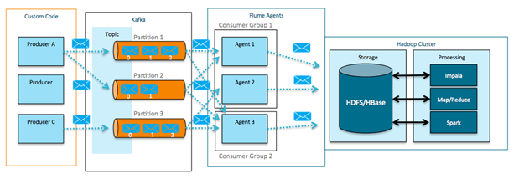
Data Flow
Making sense of the data
Step 4
Step 1
Step 2
Step 3
Step 5
CSV
Kafka
Flume
HDFS
Hive
Spark
Impala
POWER BI
MICRO STRATEGY

Slide 8
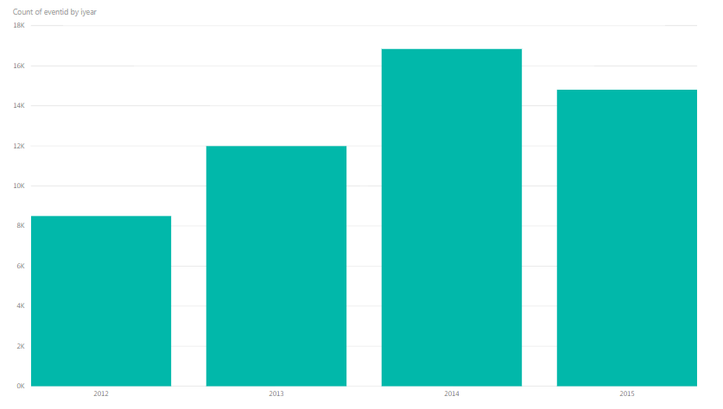
Terrorism Attack Frequency Analysis
Yearly Analysis

Slide 9
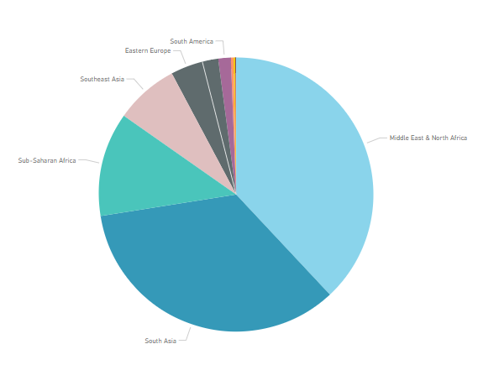
Regional Attack Analysis
Frequency Analysis

Slide 10
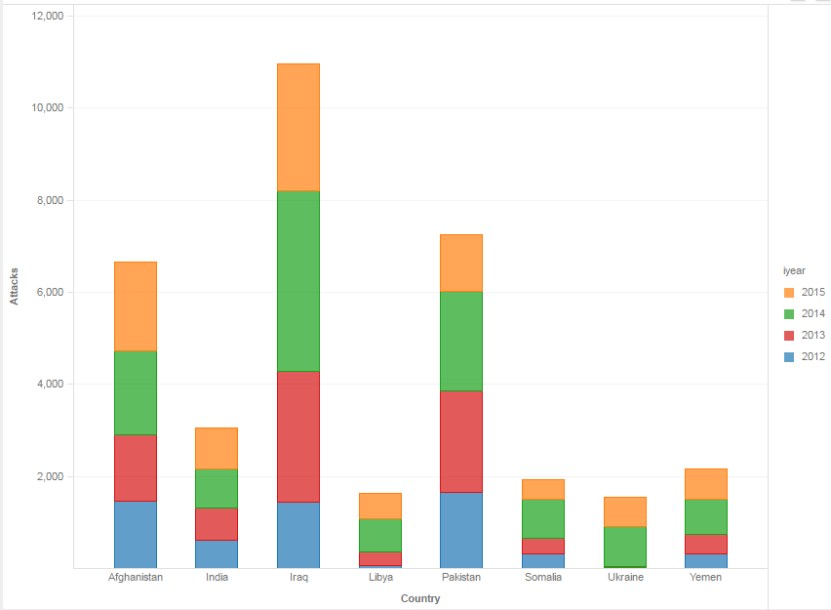
Top 8 Countries
Frequency Analysis

Slide 11
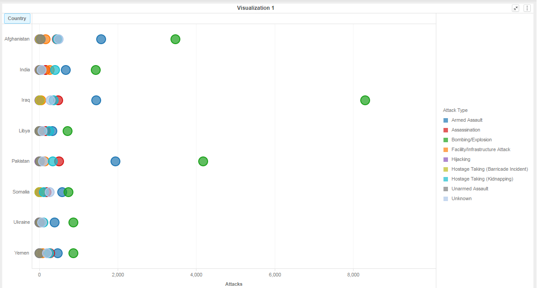
Attack Type Analysis
Frequency Analysis

Slide 12
THANK YOU

